Slide 1
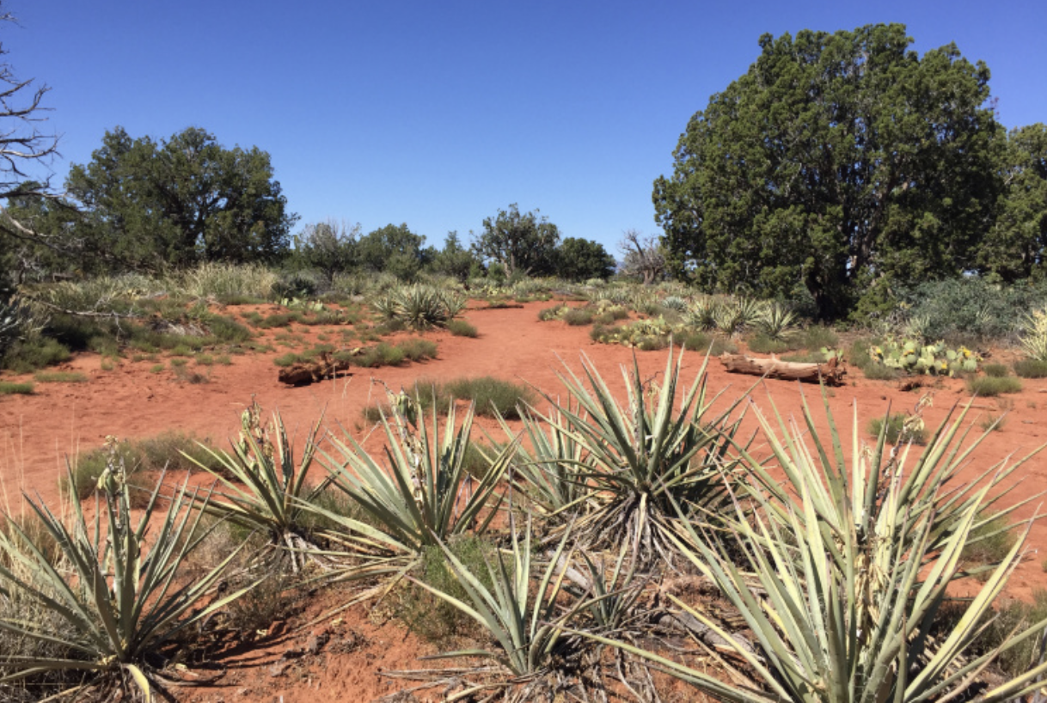
GenBio_Final_Project
By: Sarah Couture

Slide 2
Background & Introduction
Desert species have long been studied due to their outstanding ability to thrive in hot, arid climates
Studied taxa for investigating climate change and dehydration effects across species
Increase in global surface temperature
Increase in surface area of arid deserts, which is expected to increase by over 25% by 2050 (IPCC) (~6,000 sq ft annually)
Study desert species ecological evolution to ecologically prevent the extinction of at-risk species due to our ever-changing climate

Slide 3
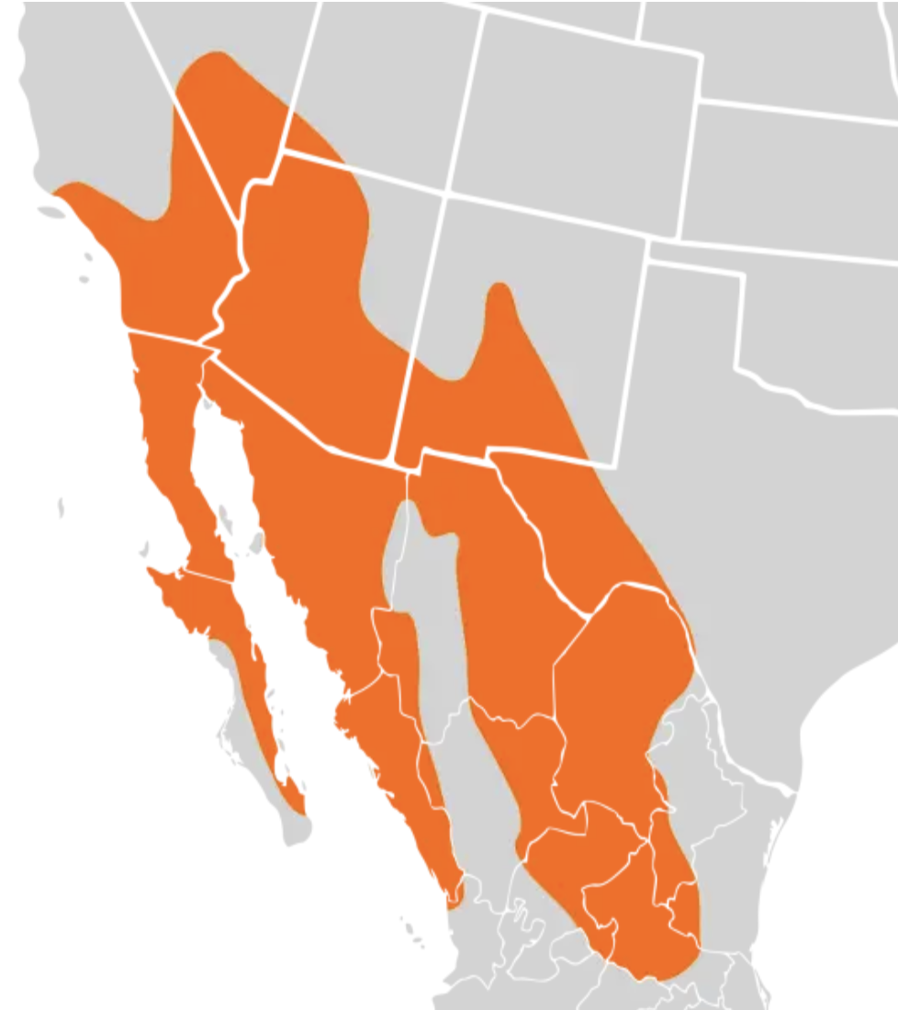
Introduction
Utilize Peromyscus eremicus mice model
”cactus mouse”
Found primarily in arid deserts in the southwestern part of the U.S.
Have ecologically adapted to desert climates over millions of years
Can go their whole lives without drinking water

Slide 4
Are there correlations between reproductive hormones and dehydration?

Slide 5
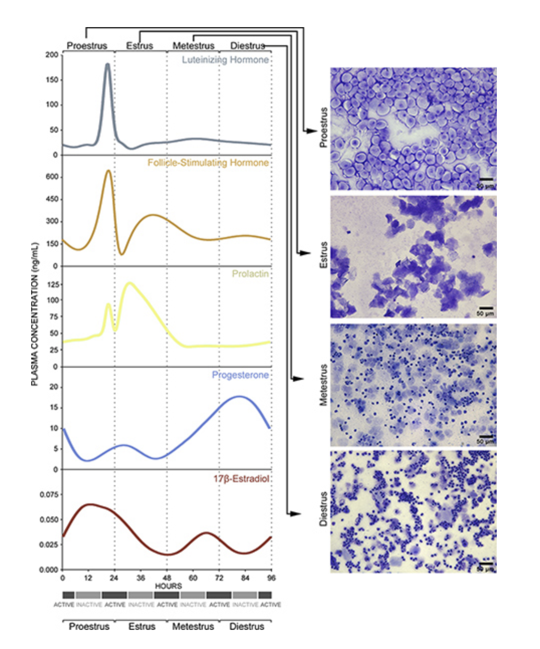
Estrus Cycle Stages & Hormonal Fluctuations
Plasma Concentration vs Time
LH
Proestrus
Mouse estrus cycle’s are approximately 4-5 days in length and are categorized by 4 stages
2 glycoprotein hormones: LH & FSH
2 steroid hormones: Progesterone & 17-β Estradiol
FSH
Estrus
Metestrus
Progesterone
17-β Estradiol
Diestrus

Slide 6
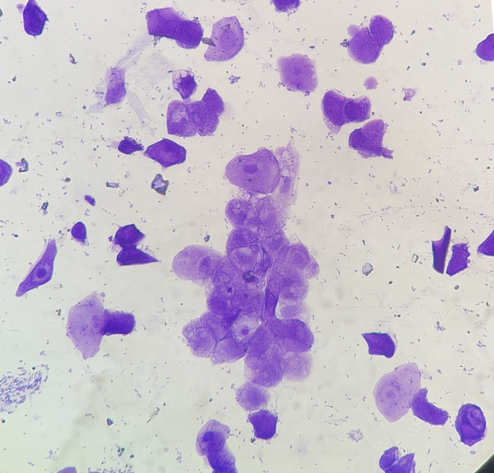
Estrus Cycle Stages & Hormonal Fluctuations
Plasma Concentration vs Time
LH
Proestrus
Mouse estrus cycle’s are approximately 4-5 days in length and are categorized by 4 stages
Proestrus, Estrus (ovulation), Metestrus, Diestrus
Proestrus: primarily erythrocytes
2 glycoprotein hormones: LH & FSH
2 steroid hormones: Progesterone & 17-β Estradiol
FSH
Estrus
Metestrus
Progesterone
17-β Estradiol
Diestrus

Slide 7
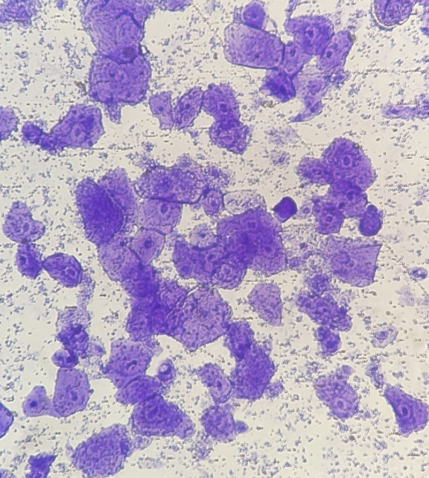
Estrus Cycle Stages & Hormonal Fluctuations
Plasma Concentration vs Time
LH
Proestrus
Mouse estrus cycle’s are approximately 4-5 days in length and are categorized by 4 stages
Proestrus, Estrus (ovulation), Metestrus, Diestrus
Proestrus: primarily erythrocytes
Estrus: primarily squamous cells
2 glycoprotein hormones: LH & FSH
2 steroid hormones: Progesterone & 17-β Estradiol
FSH
Estrus
Metestrus
Progesterone
17-β Estradiol
Diestrus

Slide 8
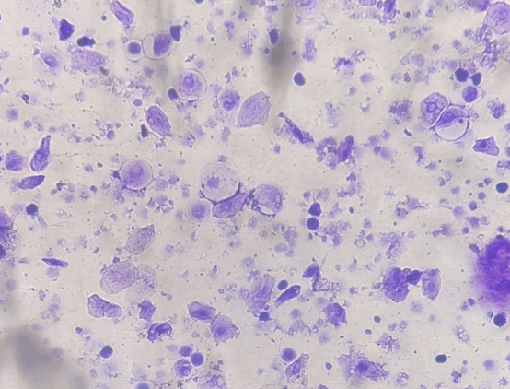
Estrus Cycle Stages & Hormonal Fluctuations
Plasma Concentration vs Time
LH
Proestrus
Mouse estrus cycle’s are approximately 4-5 days in length and are categorized by 4 stages
Proestrus, Estrus (ovulation), Metestrus, Diestrus
Proestrus: primarily erythrocytes
Estrus: primarily squamous cells
Metestrus: Combo of squamous + leukocytes, few erythrocytes
2 glycoprotein hormones: LH & FSH
2 steroid hormones: Progesterone & 17-β Estradiol
FSH
Estrus
Metestrus
Progesterone
17-β Estradiol
Diestrus

Slide 9
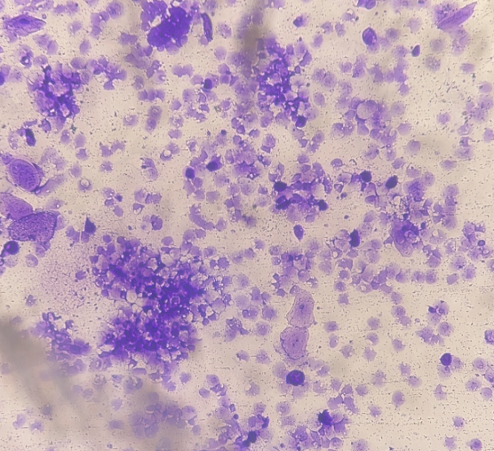
Estrus Cycle Stages & Hormonal Fluctuations
Plasma Concentration vs Time
LH
Proestrus
Mouse estrus cycle’s are approximately 4-5 days in length and are categorized by 4 stages
Proestrus, Estrus (ovulation), Metestrus, Diestrus
Proestrus: primarily erythrocytes
Estrus: primarily squamous cells
Metestrus: Combo of squamous + leukocytes, few erythrocytes
Diestrus: Coagulated leukocytes, few squamous, few erythrocytes
2 glycoprotein hormones: LH & FSH
2 steroid hormones: Progesterone & 17-β Estradiol
Estrus cycle stage confirmed via vaginal lavage
FSH
Estrus
Metestrus
Progesterone
17-β Estradiol
Diestrus

Slide 10
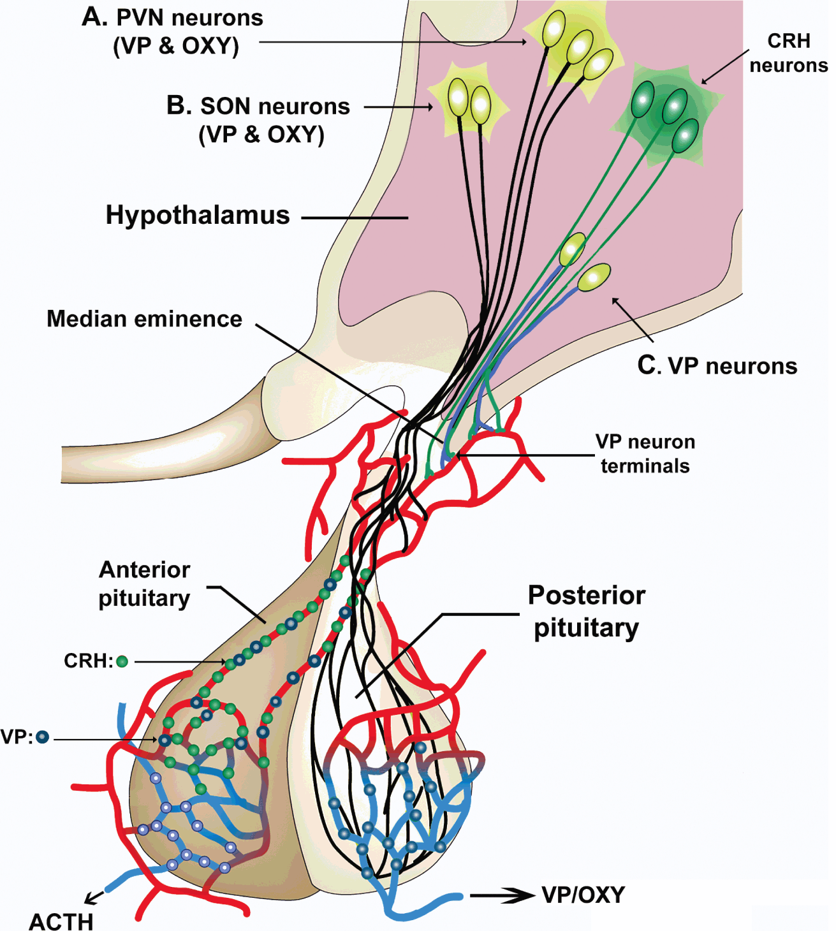
Neuronal expression of vasopressin messenger RNA (mRNA) has been shown to be estrogen dependent
What is vasopressin?
Arginine vasopressin (AVP) is an antidiuretic and vasoconstrictor
Decreases plasma osmolality (thirst control)
Where is vasopressin secreted?
Secreted by magnocellular neurons in the supra optic nucleus
(SON) & paraventricular nucleus (PVN), which is released by the
posterior pituitary and alters homeostatic function via traveling
the hypophyseal pituitary adrenal tract (HPA)

Slide 11
Hypothesis
If Estrogen Receptors regulate Vasopressin secretion and contribute to fluid balance and electrolyte homeostasis, how is the fertility of dehydrated female Peromyscus eremicus effected when in estrus?
Aim: How do hormonal levels change during a dehydration trail in female cactus mice?
Does this effect fertility?

Slide 12
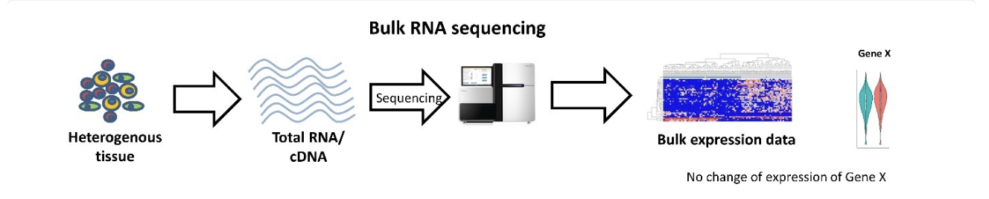
Methods
Extracted brains from female and male P. eremicus that were either hydrated (n=5 each sex) or dehydrated (n=5 each sex).
Dissected out SON, PVN (n=20), and pituitary (n=20) for sequencing.
Performed bulk RNA Illumina sequencing on all tissue samples to observe the gene expression profile of each transcript.
Indexed and mapped samples utilizing the UNH Premise cluster.
Differential gene expression analysis utilizing the DESeq2 package.

Slide 13
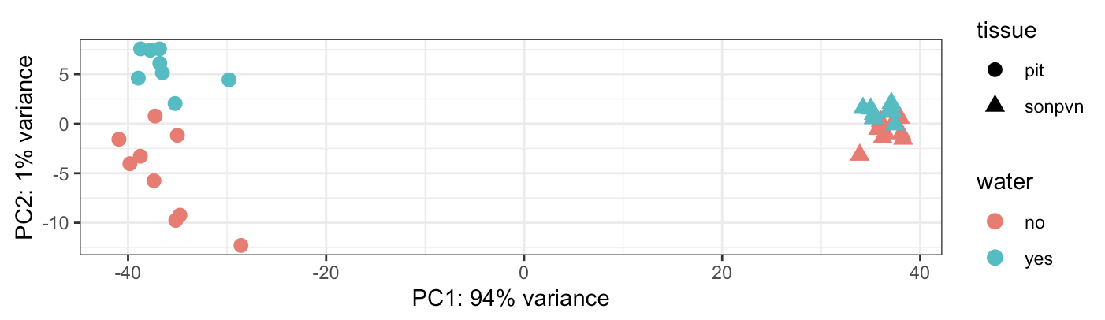
Results
Principal component analysis of gene expression of the pituitary (pit) and hypothalamus (sonpvn) of P. eremicus. The axes are labeled with the proportion of data explained by principal component 1 (tissue type) and 2 (water treatment).

Slide 14
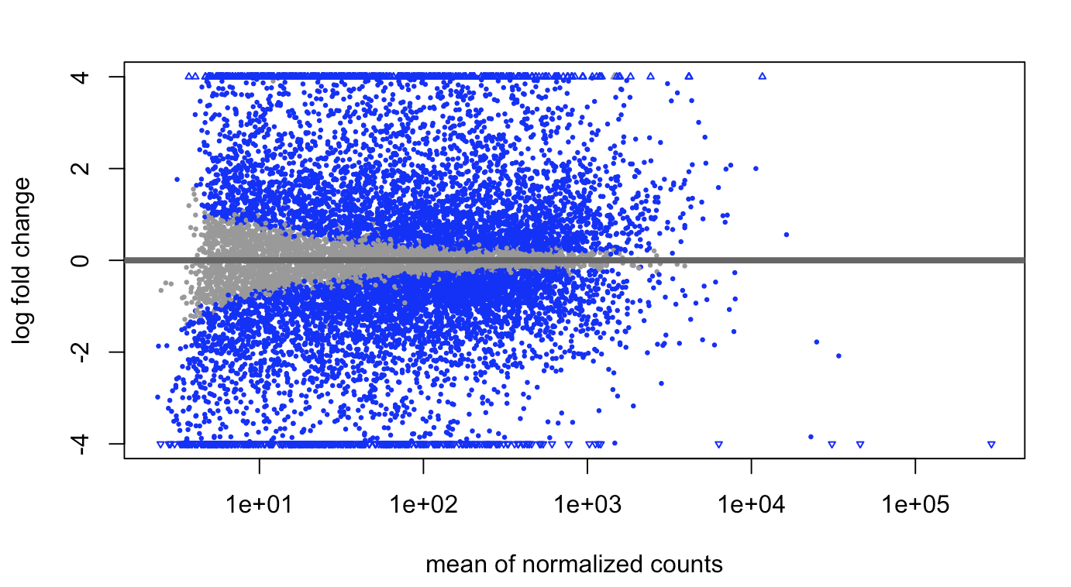
Results
MA plot showing the differential gene expression of pituitary and hypothalamus (sonpvn) in both males and female P. eremicus with or without access to water. The log fold change being on the y axis, and the mean normalized counts on the x axis.

Slide 15
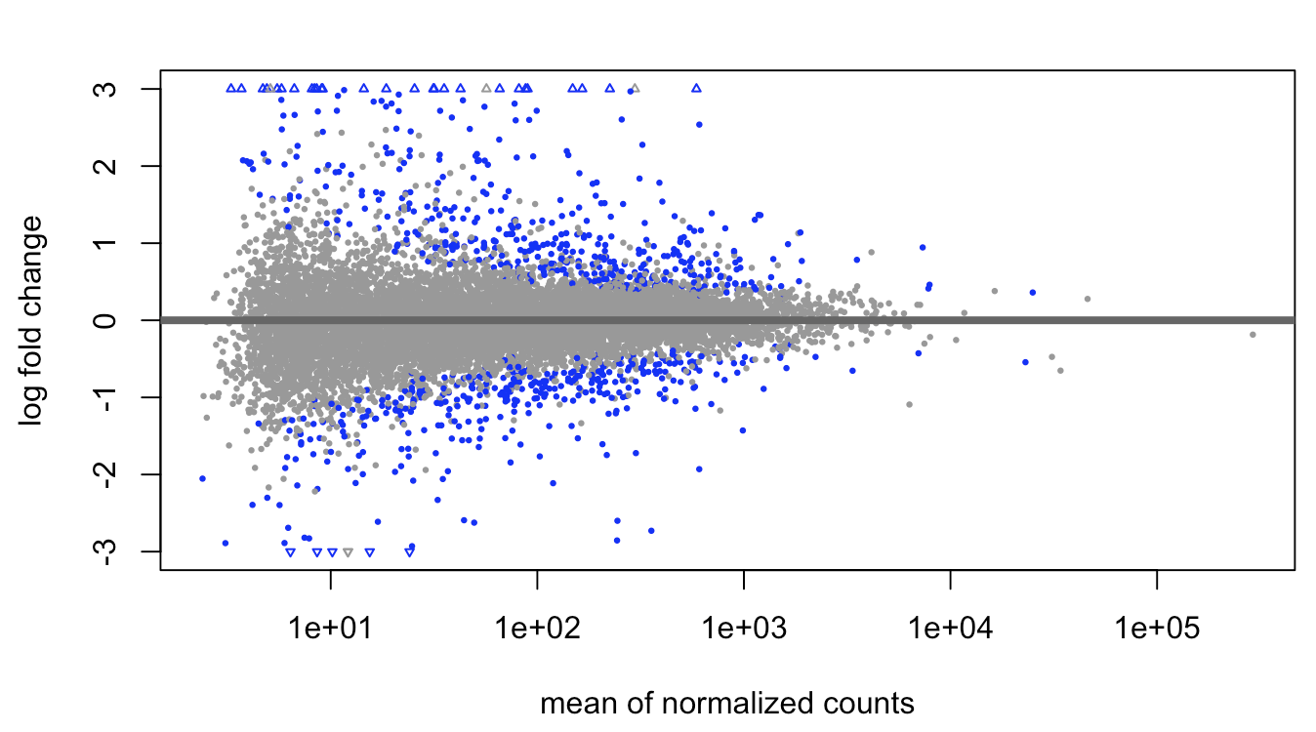
Results
MA plot showing the differential gene expression of the pituitary in both males and female P. eremicus with or without access to water. The log fold change being on the y axis, and the mean normalized counts on the x axis.

Slide 16
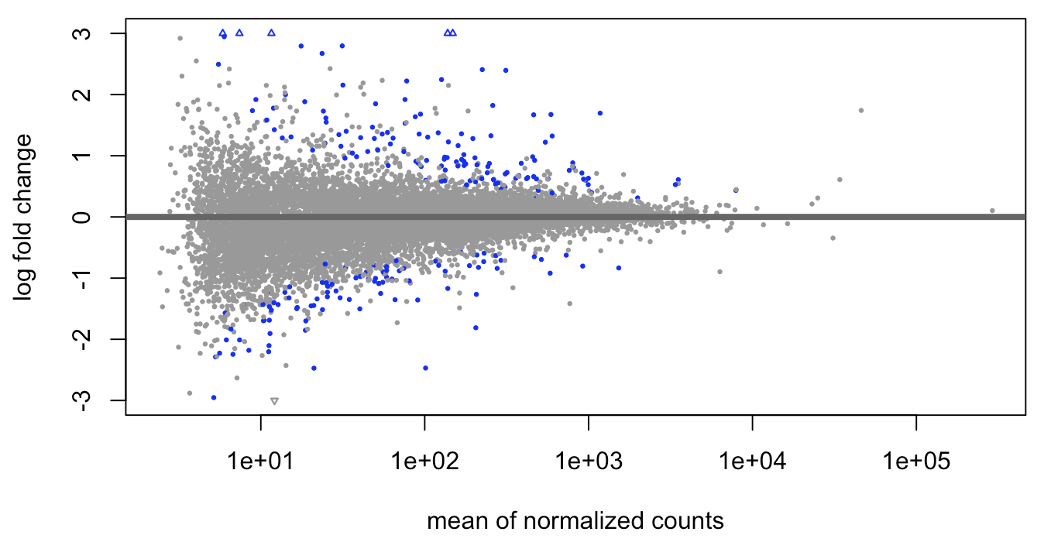
Results
MA plot showing the differential gene expression of the hypothalamus (sonpvn) in both males and female P. eremicus with or without access to water. The log fold change being on the y axis, and the mean normalized counts on the x axis.

Slide 17
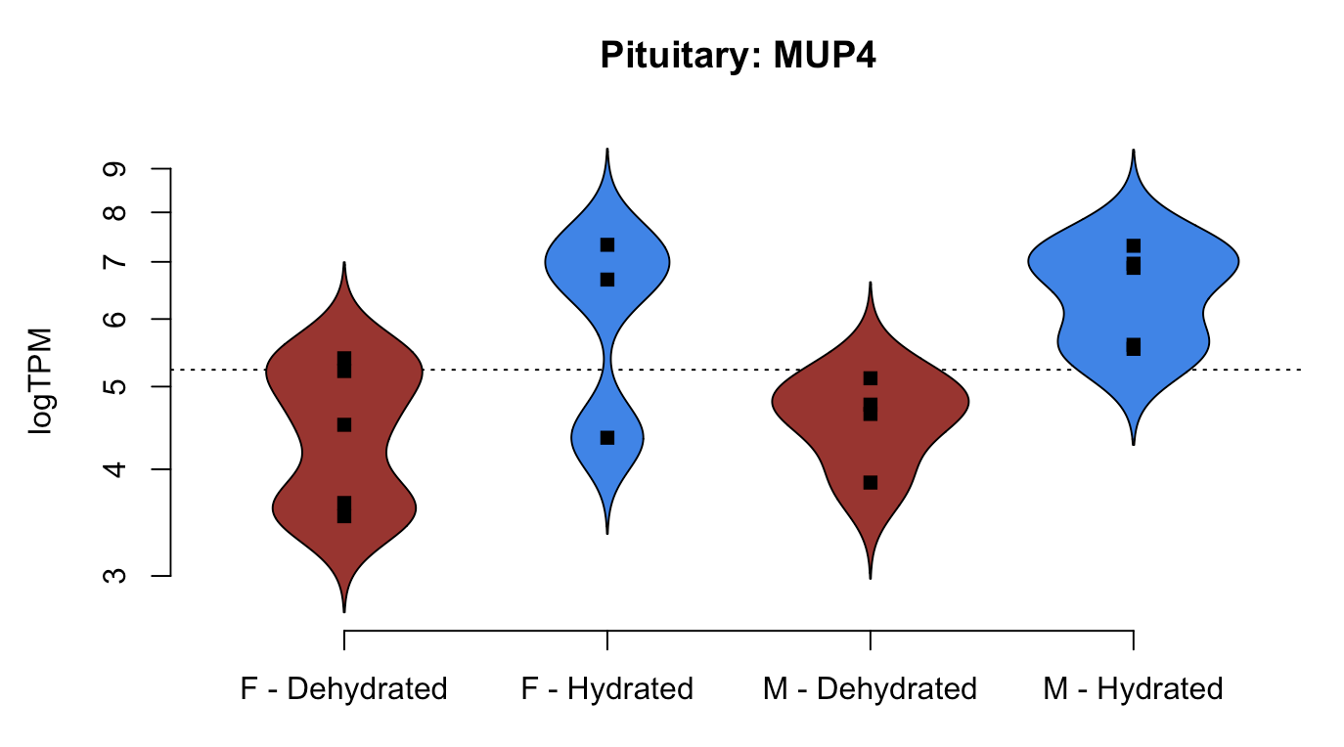
Results
Bean plot showing the log TPM on y axis, and sex and according treatment (F - Females, M - males, hydrated - with water, dehydrated - no water) on the x axis of MUP4 gene expression in the pituitary.

Slide 18
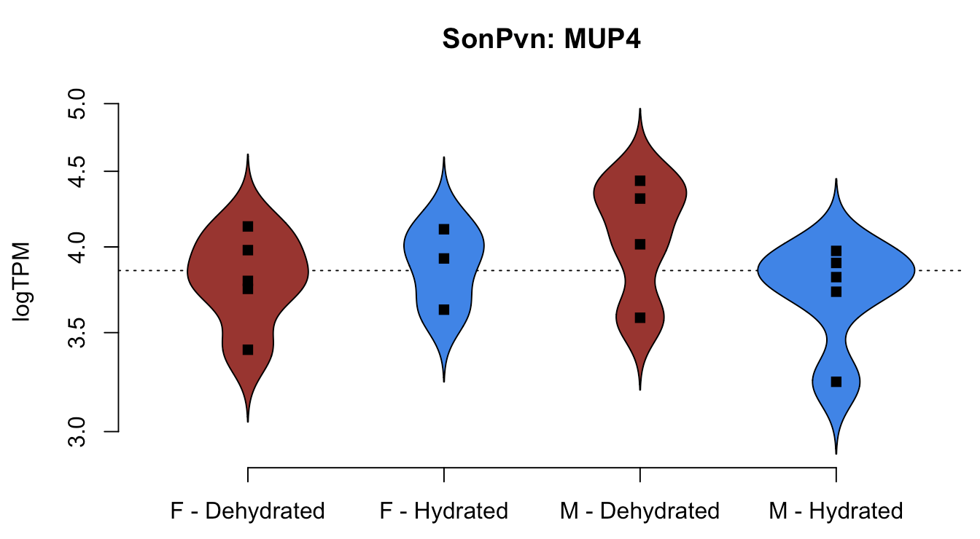
Results
Bean plot showing the log TPM on y axis, and sex and according treatment (F - Females, M - males, hydrated - with water, dehydrated - no water) on the x axis of MUP4 gene expression in the hypothalamus (sonpvn).

Slide 19
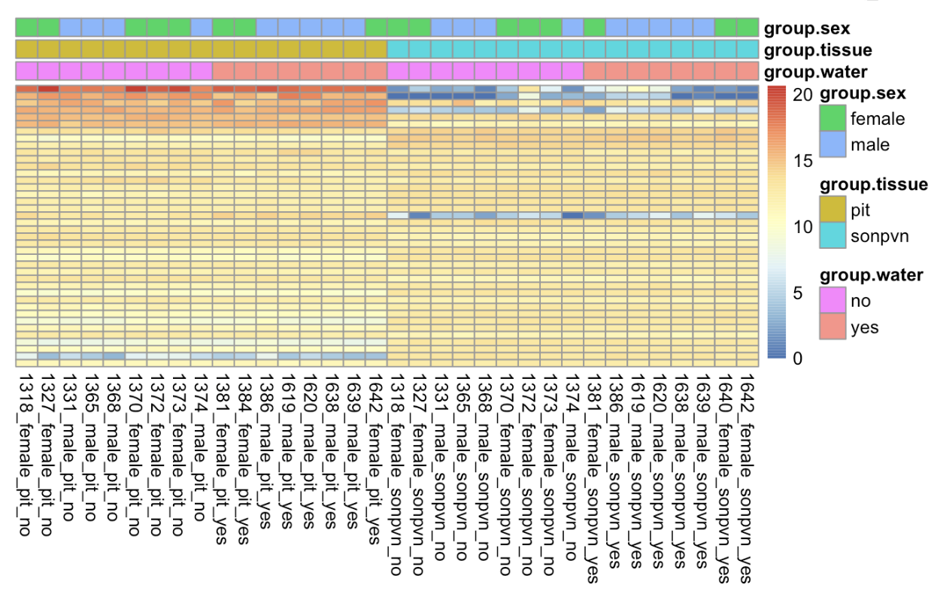
Results
Heatpmap of the differential gene expression in the pituitary and hypothalamus (sonpvn) for both hydrated (yes) and dehydrated (no) samples. Genes are on the y axis, samples are the on the x axis, and sex, tissue, and treatment groupings are colored-coded accordingly.

Slide 20
Discussion
4221 genes upregulated and 4631 genes downregulated in the SON, PVN, & pituitary (MA 1).
446 genes upregulated and 376 genes downregulated in the pituitary only (MA 2).
129 genes upregulated and 90 genes downregulated in the SON & PVN only (MA 3).
Bean plots: Differences in major urinary protein 4 (MUP4) expression (logTPM) between SON, PVN, and pituitary in female and male P. eremicus for both dehydrated and hydrated treatments (Bean plots).
These sex, treatment, and tissue correlated differences show high potential probability of dehydrational impacts on and in correlation to fertility in female desert-adapted animals on both a gene expression and correlated gene functional level.
Four genes were found to be substantially downregulated in desert-adapted hypothalamus (sonpvn) tissue (Heatmap).
6 genes were substantially up regulated in desert-adapted pituitary tissue, along with one slightly downregulated gene (Heatmap).

Slide 21
Future Directions
Gene ontology term and KEGG pathway analysis for a more comprehensive view of differential expression and gene function analysis.
Comparisons of hydrated/dehydrated P. eremicus brain to hydrated/dehydrated Mus musculus brain, which is not desert adapted.
Spatial transcriptomic analysis of P. eremicus hypothalamus to elucidate further spatial information about gene expression patterns.

Slide 22
Acknowledgments
Dr. Matthew MacManes, Sarah Nicholls, Dani Blumstein, Zahra Alim, Disha Hegde, Cassidy O’Brien, and Sahar Jamialahmadi for their help and guidance.
Matthew MacManes, Xuanmao Chen, Paul Tsang, David Plachetzki, Brittany Jellison.
The University of New Hampshire Animal Resources Office (Linnea Morley, Dean Elder) and Hubbard Genome Center for their support and resources.
The National Institute of Health – Grant # R35 GM128843.

Slide 23
References
1. Heldring N, et al. Estrogen receptors: how do they signal and what are their targets. Physiol Rev. 2007;87(3):905–31.
2. Pfaff DW, et al. Cellular and molecular mechanisms of female reproductive behaviors. In: Knobil E, Neill JD, editors. The Physiology of Reproduction. Raven Press, Ltd; 1994. pp. 107–220.
3. Klinge CM. Estrogen receptor interaction with estrogen response elements. Nucleic Acids Res. 2001;29(14):2905–19.
4. Marino M, et al. Estrogen signaling multiple pathways to impact gene transcription. Curr Genomics. 2006;7(8):497–508.
5. Eddy EM, Washburn TF, Bunch DO, Goulding EH, Gladen BC, Lubahn DB, Korach KS. Targeted disruption of the estrogen receptor gene in male mice causes alteration of spermatogenesis and infertility. . Endocrinology. 1996;137:4796–4805.
6. Hess RA, Bunick D, Lee KH, Bahr J, Taylor JA, Korach KS, Lubahn DB. A role for oestrogens in the male reproductive system. . Nature. 1997;390:509–512.
7. Sladek CD. Estrogen receptors: Their roles in regulation of vasopressin release for maintenance of fluid and electrolyte homeostasis. Neuroendocrinology. 2007. pp. 114-127.

